Slide 1

Stage 5 Work The Corners Course Designer: Eric Beerbaum
Work The Corners is a 19 round, 95 point Comstock medium course. There are 8 USPSA targets and 3 steel targets. The best two hits per target will score. Steel must fall to score. The start signal is audible.
The Handgun start position is heels touching start stick, handgun loaded and holstered, wrists below belt. The PCC start position is heels touching start stick, PCC loaded, stock on belt, muzzle generally downrange.
On the audible start signal, engage all targets within the shooting area.

Slide 2
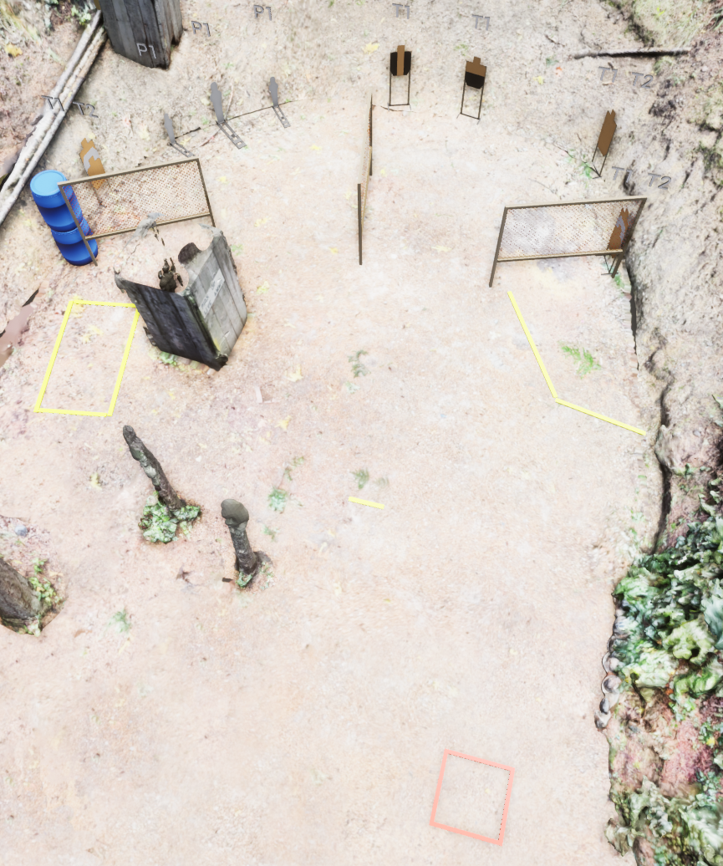
 | Stage 5 Work The Corners Course Designer: Eric Beerbaum

